Slide 1
Lightning Web components
On-Core and Off-Core
Andrés Pérez
Senior Manager, Trailhead Academy Solution Architect Lead

Slide 2


Forward-Looking Statements
"Safe harbor" statement under the Private Securities Litigation Reform Act of 1995: This presentation contains forward-looking statements about the company's financial and operating results, which may include expected GAAP and non-GAAP financial and other operating and non-operating results, including revenue, net income, diluted earnings per share, operating cash flow growth, operating margin improvement, expected revenue growth, expected current remaining performance obligation growth, expected tax rates, stock-based compensation expenses, amortization of purchased intangibles, shares outstanding, market growth, environmental, social and governance goals and expected capital allocation, including mergers and acquisitions, capital expenditures and other investments. The achievement or success of the matters covered by such forward-looking statements involves risks, uncertainties and assumptions. If any such risks or uncertainties materialize or if any of the assumptions prove incorrect, the company’s results could differ materially from the results expressed or implied by the forward-looking statements it makes.
The risks and uncertainties referred to above include -- but are not limited to -- risks associated with the effect of general economic and market conditions; the impact of geopolitical events, natural disasters and actual or threatened public health emergencies, such as the ongoing Coronavirus pandemic; the impact of foreign currency exchange rate and interest rate fluctuations on our results; our business strategy and our plan to build our business, including our strategy to be the leading provider of enterprise cloud computing applications and platforms; the pace of change and innovation in enterprise cloud computing services; the seasonal nature of our sales cycles; the competitive nature of the market in which we participate; our international expansion strategy; the demands on our personnel and infrastructure resulting from significant growth in our customer base and operations, including as a result of acquisitions; our service performance and security, including the resources and costs required to avoid unanticipated downtime and prevent, detect and remediate potential security breaches; the expenses associated with our data centers and third-party infrastructure providers; additional data center capacity; real estate and office facilities space; our operating results and cash flows; new services and product features, including any efforts to expand our services beyond the CRM market; our strategy of acquiring or making investments in complementary businesses, joint ventures, services, technologies and intellectual property rights; the performance and fair value of our investments in complementary businesses through our strategic investment portfolio; our ability to realize the benefits from strategic partnerships, joint ventures and investments; the impact of future gains or losses from our strategic investment portfolio, including gains or losses from overall market conditions that may affect the publicly traded companies within our strategic investment portfolio; our ability to execute our business plans; our ability to successfully integrate acquired businesses and technologies; our ability to continue to grow unearned revenue and remaining performance obligation; our ability to protect our intellectual property rights; our ability to develop our brands; our reliance on third-party hardware, software and platform providers; our dependency on the development and maintenance of the infrastructure of the Internet; the effect of evolving domestic and foreign government regulations, including those related to the provision of services on the Internet, those related to accessing the Internet, and those addressing data privacy, cross-border data transfers and import and export controls; the valuation of our deferred tax assets and the release of related valuation allowances; the potential availability of additional tax assets in the future; the impact of new accounting pronouncements and tax laws; uncertainties affecting our ability to estimate our tax rate; uncertainties regarding our tax obligations in connection with potential jurisdictional transfers of intellectual property, including the tax rate, the timing of the transfer and the value of such transferred intellectual property; the impact of expensing stock options and other equity awards; the sufficiency of our capital resources; factors related to our outstanding debt, revolving credit facility and loan associated with 50 Fremont; compliance with our debt covenants and lease obligations; current and potential litigation involving us; and the impact of climate change.
Further information on these and other factors that could affect the company’s financial results is included in the reports on Forms 10-K, 10-Q and 8-K and in other filings it makes with the Securities and Exchange Commission from time to time. These documents are available on the SEC Filings section of the Investor Information section of the company’s website at.
Salesforce.com, inc. assumes no obligation and does not intend to update these forward-looking statements, except as required by law.
Third party trademarks are the property of their owners.
Notes:
Key Message Salesforce is a publicly traded company. Customers should make buying decisions only on the products commercially available. Talk Track But, before I begin, I just want to give a quick reminder that customers should base their purchasing decisions on products and services that are currently available.

Slide 3


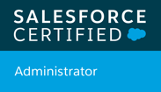

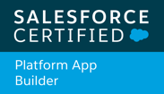


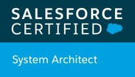
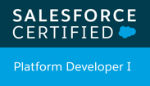
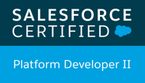
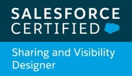


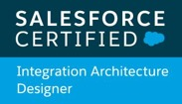



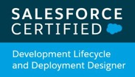
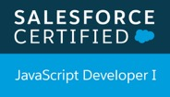
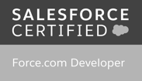
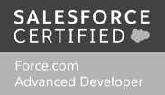


Andrés Pérez
ELTOROIT
Senior Manager, Trailhead Academy Solution Architect Lead

Slide 4
Agenda
Por qué usar Off-Core?
Como crear una aplicación de LWC Off-Core?
Qué es igual en Off-Core?
Qué es parecido en Off-Core?
Qué no funciona en Off-Core?
Ideas y Trucos (Tips and Tricks)
Q&A

Slide 5
Por qué usar Off-Core?
Notes:
Steps:
Open https://lwc.dev/
Open the terminal
$ cd /Users/aperez/DO NOT BACKUP/TEMP
$ npx create-lwc-app demo
Running it takes 5 minutes… no need to wait.
$ cd my-app
$ npm run watch

Slide 6
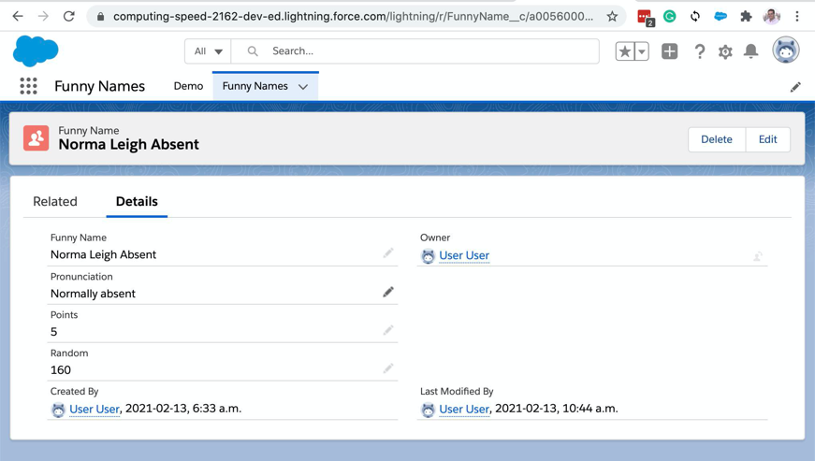
On-Core vs. Off-Core
On-Core
Off-Core
Se ejecuta por fuera de Salesforce
Pero porque?
Locking service no te permite usar algo que necesitas
Tu base de datos no está en Salesforce
No quieres licencias para tus usuarios
En mi caso, necesito usar web sockets
Pero antes de usar Off-Core…
Considera Salesforce Communities

Slide 7
Como crear una aplicación de LWC Off-Core?

Slide 8
Demo...
Notes:
Steps:
Open https://lwc.dev/
Open the terminal
$ cd /Users/aperez/DO NOT BACKUP/TEMP
$ npx create-lwc-app demo
Running it takes 5 minutes… no need to wait.
$ cd my-app
$ npm run watch

Slide 9
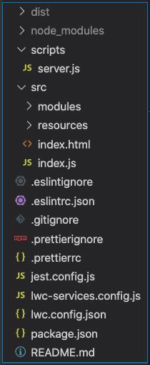
Qué creó este paso?
El proyecto contiene:
LWC code original
LWC compiled code
Static Resources
Component Loader
HTTP Server
LWC configuration
Project configuration

Slide 10
Qué creó este paso?
El proyecto contiene:
LWC code original
LWC compiled code
Static Resources
Component Loader
HTTP Server
LWC configuration
Project configuration

Slide 11
Qué creó este paso?
El proyecto contiene:
LWC code original
LWC compiled code
Static Resources
Component Loader
HTTP Server
LWC configuration
Project configuration

Slide 12
Qué creó este paso?
El proyecto contiene:
LWC code original
LWC compiled code
Static Resources
Component Loader
HTTP Server
LWC configuration
Project configuration
src/index.html main HTML page that gets served
src/index.js controller for that page

Slide 13
Qué creó este paso?
El proyecto contiene:
LWC code original
LWC compiled code
Static Resources
Component Loader
HTTP Server
LWC configuration
Project configuration

Slide 14
Qué creó este paso?
El proyecto contiene:
LWC code original
LWC compiled code
Static Resources
Component Loader
HTTP Server
LWC configuration
Project configuration
lwc-services.config.js defines which files to copy
jest.config.js defines how LWC gets compiled

Slide 15
Qué creó este paso?
El proyecto contiene:
LWC code original
LWC compiled code
Static Resources
Component Loader
HTTP Server
LWC configuration
Project configuration

Slide 16
Qué es igual en Off-Core?
Los siguientes puntos funcionan en Off-Core, sin necesidad de hacer cambios al código.

Slide 17
Qué es igual en Off-Core?
LWC
HTML Templates
JavaScript
CSS
etc.
Events
this.dispatchEvent(new CustomEvent());
Decorators
@api
@track
VS Code

Slide 18
Qué es parecido en Off-Core?
Los siguientes puntos NO funcionan directamente en Off-Core por que no estamos dentro de Lightning Experience, pero haciendo unos pequeños cambios podemos usarlos.

Slide 19
Qué es parecido en Off-Core?
Con qué cosas te ayuda Salesforce (Lightning Experience)
Salesforce Lightning Design System (SLDS)
Componentes standard de Salesforce
<Lightning-button />, etc
Static resources

Slide 20
Salesforce Lightning Design System (SLDS)
Las clases de SLDS usadas en el código son iguales
Pero nosotros tenemos que importar SLDS
Importar al proyecto $ npm i @salesforce-ux/design-system
Modificar este archivo lwc-services.config.js, para copiar archivos al folder de código compilado (dist). resources: [ { from: 'node_modules/@salesforce-ux/design-system/assets', to: 'dist/SLDS' } ]
Modificar este archivo index.html, para importar archivos al browser <link rel="stylesheet" href="/SLDS/styles/salesforce-lightning-design-system.min.css" />

Slide 21
Componentes standard de Salesforce
<Lightning-button />, etc
Los components standard usados en el código son iguales
Pero nosotros tenemos que importar esos components
Importar al proyecto $ npm i lightning-base-components
Modificar este archivo lwc.config.json, para compilar el código "modules": [ { "npm": "lightning-base-components" } ]

Slide 22
Static Resources
Los archivos que generalmente se encuentran en Static Resources tienen que ser copiados
Coloca los archivos en src/resources
Modificar este archivo lwc-services.config.js, para copiar archivos al folder de código compilado (dist). resources: [ { from: 'src/resources/', to: 'dist/resources/' } ]

Slide 23
Qué no funciona en Off-Core?
Los siguientes puntos NO funcionan en Off-Core, y toca pensar en alternativas.

Slide 24
Qué no funciona en Off-Core?
Qué necesitas diseñar diferente?
Toasts
Lightning Message Service
@wire

Slide 25
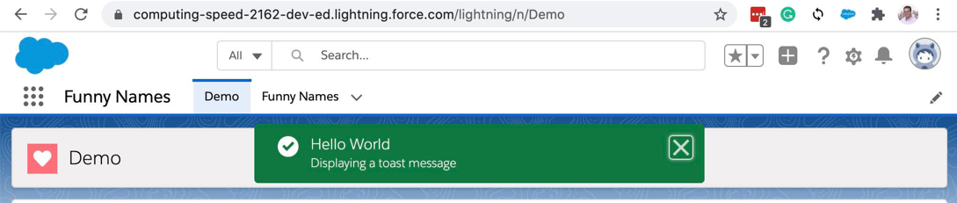
Toasts
Toasts son una via de communication con el usuario muy importate,
Pero no estan disponibles Off-Core!
Yo estoy usando una libreria gratis, que funciona bastante bien Off-Core: $ npm i toastify-js

Slide 26
Lightning Message Service
Lightning Message Service
Comunicación entre componentes que no están en el mismo DOM tree
Tiene soporte en estas experiencias
Lightning Experience (incluyendo standard y consola)
Salesforce mobile app (Aura y LWC), pero no para Visualforce pages
Lightning components usados en Experience Builder sites (Beta)
No tiene soporte para
Visualforce pages en Experience Builder sites
Salesforce Tabs en sitios Visualforce sites
Not available Off-Core
You could use the Salesforce provided pubSub library: https://github.com/developerforce/pubsub

Slide 27
@wire
@wire in LWC sirve para conectar el client-side con el back-end
@wire se puede conectar con:
Lightning Data Service
Ejemplos
import { getRecord, getFieldValue } from 'lightning/uiRecordApi';
import { createRecord, updateRecord } from 'lightning/uiRecordApi';
Estas funciones las provee Salesforce cuando estas On-Core
Esto no funciona en Off-Core
Apex
Ejemplos
import getContactList from '@salesforce/apex/ContactController.getContactList';
Apex imports también se puede usar con Imperative Apex
Apex no funciona en otros servidores!

Slide 28
Pero como traigo los datos?
Excelente pregunta!
Qué bueno que hayas preguntado…
Puedes simular Apex :-)
Imperative Apex
@wire Apex

Slide 29
Imperative Apex simulado (I)
No necesitas cambiar tu LWC código!*
Supongamos que tienes esto import shuffle from "@salesforce/apex/Shuffle.lwc";
Para llamar este método global with sharing class Shuffle { @AuraEnabled public static void lwc() { … } }
Debes crear este LWC component: src/modules/@salesforceApex/shuffle.lwc/shuffle.lwc.js
* Esto es casi cierto :-) Detalles más adelante...

Slide 30
Imperative Apex simulado (II)
src/modules/@salesforceApex/shuffle.lwc/shuffle.lwc.js
export default async function Shuffle_LWC(params) { const getData = async (output) => { /*Get the data*/ }
let output = {}; await getData(output); return output; }
getData() se conecta con el servidor y trae datos.

Slide 31
Apex simulado + @wire (I)
No necesitas cambiar tu LWC código!*
Supongamos que tienes esto import getFunnyName from '@salesforce/apex/GetFunnyName.lwc';
Para llamar este método global with sharing class GetFunnyName { @AuraEnabled(cacheable=true) public static FunnyName__c lwc(Id recordId) { … } }
Debes crear este LWC component: src/modules/@salesforceApex/getFunnyName.lwc/getFunnyName.lwc.js
* Esto es casi cierto :-) Detalles más adelante...

Slide 32
Apex simulado + @wire (II)
src/modules/@salesforceApex/getFunnyName.lwc/getFunnyName.lwc.js
export default class GetFunnyName_LWC { config; dataCallback = {}; connected = false; constructor(dataCallback) { this.dataCallback = dataCallback; } connect() { this.connected = true; this.returnData(this.config); } disconnect() { this.connected = false; } update(config) { this.config = config; this.returnData(this.config);} async returnData() { this.dataCallback(await this.getData(output)); } async getData(output) { /*Get the data*/ } }
getData() se conecta con el servidor y trae datos.

Slide 33
Apex simulado + @wire (III)
Pero se puede usar refreshApex()?
Cuando devuelvas los datos del @wire, devuelve una referencia a tu objeto async returnData() { let output = { data: null, error: null, refreshApex: this }; this.dataCallback(await this.getData(output)); }
Crea este archivo: src/modules/@salesforce/apex/apex.js export async function refreshApex(wiredResults) { wiredResults.refreshApex.returnData(); }

Slide 34
Te diste cuenta del nombre para el folder?
En el LWC codigo, tengo esto... import getFunnyName from '@salesforce/apex/GetFunnyName.lwc';
Pero en el nombre del componente, tengo esto… src/modules/@salesforceApex/getFunnyName.lwc/getFunnyName.lwc.js
Esto lo soluciono cuando hago el build de On-Core LWC
Tengo un Bash script (build.sh) para cambiar “salesforce/apex” a “salesforceApex”

Slide 35
Ideas y Trucos
Tips and Tricks

Slide 36
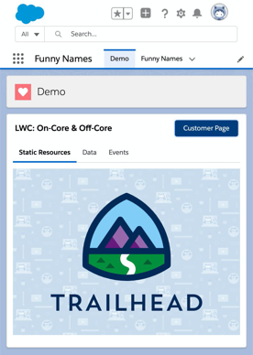
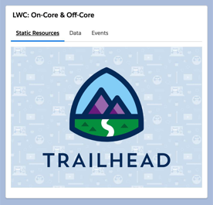
System Architecture
LWC Server
API Server
Off-Core
On-Core
But different environments
Scratch org
Sandbox
Production
Each with different servers, but same code!

Slide 37
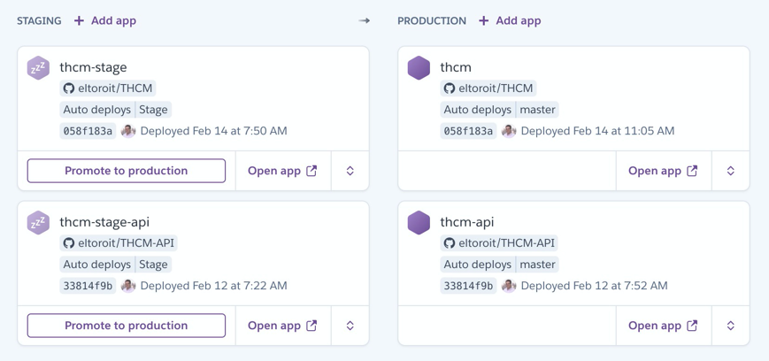
Heroku Pipeline
Diferentes aplicaciones, por que no hay different ports
GitHub integration
“Promote to Production” button
Procfile

Slide 38
Cómo organicé los componentes?
Index.html
Index.js
Off-Core
c-main
App Builder Page
c-on-core-wrapper
On-Core

Slide 39
Pero algunas variables son diferentes!
Off-Core
Set on index.js
window.LWC_Demo = {
inOrg: "NO",
toastify: Toastify,
resources: `/resources/ELTOROIT`,
servers: {
API: serverAPI,
LWC: window.location.origin
}
}
On-Core
Set on onCoreWrapper.js
window.LWC_Demo = {
inOrg: "YES",
LWC_ShowToastEvent: ShowToastEvent,
resources: ELTOROIT,
servers = await getServersApex();
}
import { ShowToastEvent } from "lightning/platformShowToastEvent";
import ELTOROIT from "@salesforce/resourceUrl/ELTOROIT";
import getServersApex from '@salesforce/apex/GetServers.lwc';

Slide 40
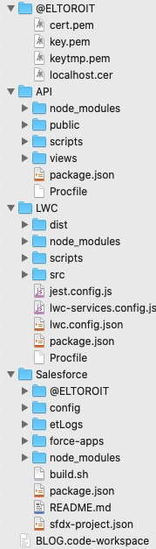
Cómo organicé el proyecto?
Diferentes carpetas
Carpetas
@ELTOROIT
Certificados (más seguro, ya que no están en el mismo repo)
LWC
LWC Server
Los usuarios abren una página de este servidor desde el browser.
API:
API Server
Se conecta con la base datos (Salesforce u oro)
LWC y API estan separados!
LWC permite crear un servidor (funciona en otro puerto).
Heroku no permite tener varias aplicaciones con puertos diferentes basados en el mismo repo (Más fácil tener 2 aplicaciones)

Slide 41
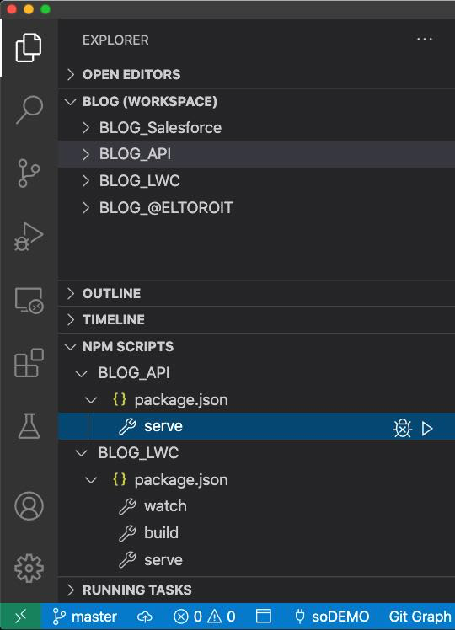
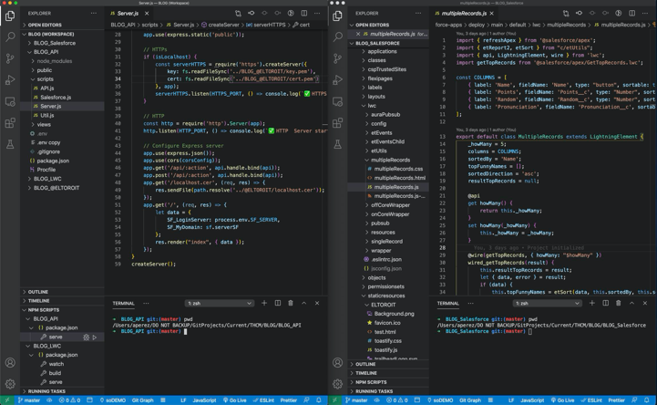
VS Code Workspace
VS Code puede trabajar con varias carpetas
Necesitas un “workspace”
Cada folder tiene sus archivos independientes
Incluyendo Git (para Heroku)
Incluyendo package.json (para npm scripts)
Puedes ejecutar o debug cada aplicación por separado
Salesforce necesita estar en un proyecto aparte
Debes abrir Salesforce en otra ventana de VS Code
API & LWC
Salesforce

Slide 42
Salesforce Folder (I)
Que me ha ayudado?
ETCopyData
https://github.com/eltoroit/ETCopyData
Cargar datos de tu repo a un scratch org
Scratch Org Template
https://github.com/eltoroit/ETScratchOrgsStarter
Shell script para crear un scratch org
Github YAML
Folders separados
Deploy
DoNotDeploy
Profiles
Custom metadata
Server URLs (Diferentes valores para cada org -- scratch org, sandbox, production)
Test Page
staticresources/ELTOROIT/test.html

Slide 43
Salesforce Folder (II)
Que me ha ayudado?
Custom Metadata
Ayuda a identificar servers
Localhost
Heroku Staging
Heroku Production
VS Code
.vscode/tasks.json para ejecutar este Build.sh script.
Build.sh
Copy LWC from Salesforce folder to LWC folder
Updates paths for ‘@salesforce/apex’
Makes LWC folder read only
chmod -R 555 .
Pushes to scratch org

Slide 44
API Folder
If making a call to API server from Salesforce
Make sure you configure CORS
HTTPS requires SSL certificates
Page to show which Salesforce org it’s connected to
https://<API_Server>/salesforce
Remember we have different environments?
JSForce to connect to Salesforce data
https://jsforce.github.io/

Slide 45
LWC Folder
Print compiled date
Tests in case caching is not showing the latest code
Set variables in index.js file
Decided not to use the API server built by LWC
More control by having different apps

